Slide 1
CSS3 Flex Box
flexsible Layout

Slide 2
Agenda
Introduction:
What is Flex
Why we need Flex
Flex Syntax & Properties
Flex Display
Flex-direction
Flex-wrap
Flex-flow
Justify-content
Align-items
flex: none | flex-grow flex-shrink flex-basis
Flex order
Examples

Slide 3
We love Floats
It’s a question not a statement.

Slide 4
Floats and Issues
• Weird behaving
• Clearfix
• Cross- browser issues
• Parent container breaking
• Content spill over

Slide 5
Floats and Issues
Flexible parent container
No floats Hack
no clear fix
adjustable child container
What you want to change?

Slide 6
Why Flexbox?
What is Flex?
Flexbox or Flexible box is the css3 property
Flexbox is the layout mode
Improvement over the Floats
It helps in displaying the elements on the page as per
Ability to make all neighboring items the same height
It helps in achieving the grid layout
Easy horizontal and vertical centering
Ability to change the display order of the items independent of the html soruce
CSS Layout Module - offers greater control over arranging components of web pages items along one axis.
The Flexible Box Layout Module, makes it easier to design flexible responsive layout structure without using float or positioning.

Slide 7
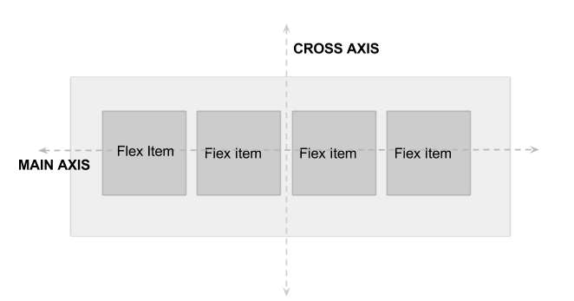
Let’s Meet the Flex (Flex Vocabulary)

Slide 8
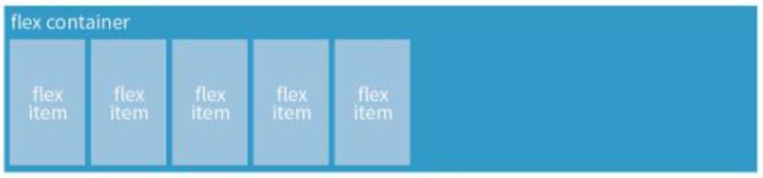
Flexbox Container
Flexbox Container
You can create a flex container by setting the ele’s display property to flex|inline-flex

Slide 9
Flexbox Container
.flex-container{
display: flex;
}
OR
.flex-container{
display: inline-flex;
}
Display: flex creates a block-level flex container
Display: inline-flex creates a inline-level flex container

Slide 10
Flexbox Container
Flex items
applying the flex display mode turns the child elements of the flex container into flex items
Note: You can turn any flex item into a flex container by setting its display to flex (resulting in nested flexbox)

Slide 11
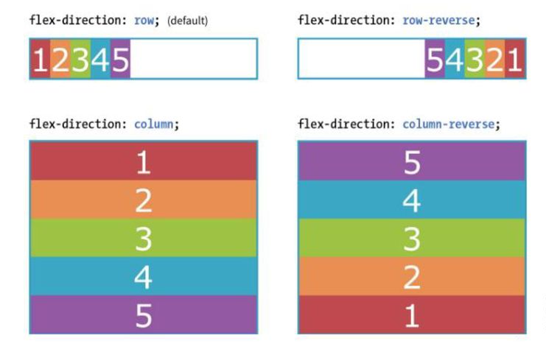
Flexbox Container
Flex Container - Properties
Flex container properties allow you to control how items appear within the container
flex-direction
row | column | row-reverse | column-reverse

Slide 12
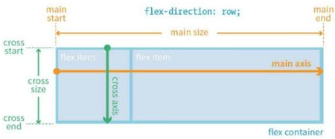
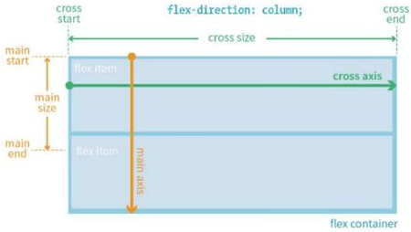
Flexbox Container
Flex items
When flex-direction is set to row, the main axis is horizontal and the cross axis is vertical
FFlex items line up along one axis
Main axis -or- cross axis
The main axis is the flow direction you’ve specified for the flex container. The cross axis is perpendicular to the main axis
Note: axis direction is specified t the direction of the writing system in use.
For Example: write In horizonally oriented languages - ‘row’ would align items horizontally.
Vertically oriented languages - ‘column’ would align items vertically
When flex-direction is set to column, the main axis is vertical and the cross axis is horizontal

Slide 13
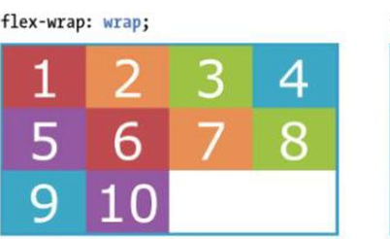
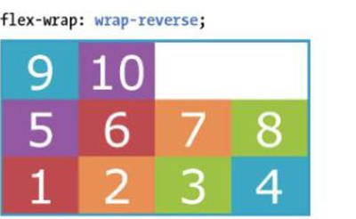
Flexbox Container
flex-wrap (flex-direction: row;)
nowrap(default) | wrap | wrap-reverse. When wrapping is disabled, flex items squish if there is not enough room, and if they can’t squish any further, may get cut off if there is not enough room in the viewport.
The markup
<div id=”container”>
<div class=”box box1”>1</div>
----------------------------------
<div class=”box box10”>10</div>
</div>
The styles
#container {
display: flex;
flex-direction: row;
flex-wrap: wrap;
}
.box {
width: 25%;
}

Slide 14
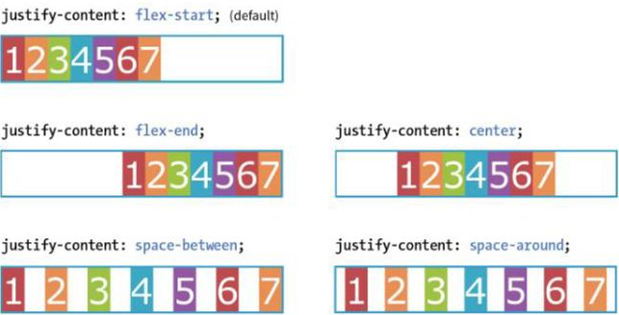
Flexbox Alignment
justify-content (flex-direction: row;)
flex-start | flex-end | center | space-between | space-around.
Flex items are, by default, as wide as they need to be to contain the element’s content.
The justify-content property defines how extra space is distributed around or between items.

Slide 15
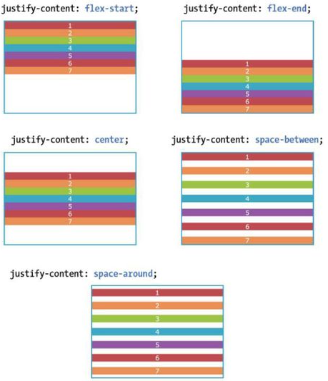
Flexbox Alignment
justify-content (flex-direction: column;)
flex-start | flex-end | center | space-between | space-around.
Flex items are, by default, as wide as they need to be to contain the element’s content.
The justify-content property defines how extra space is distributed around or between items.

Slide 16
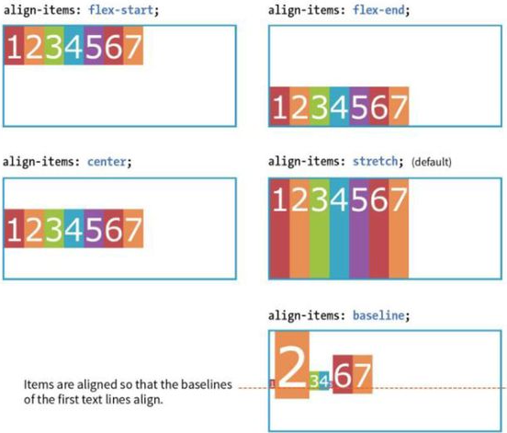
Flexbox Alignment
align-items
flex-start | flex-end | center | baseline | stretch
The align-items property allows you to arrange items on the cross axis (up and down when the direction is row, left and right if the direction is column).
Note: you must specify a container height

Slide 17
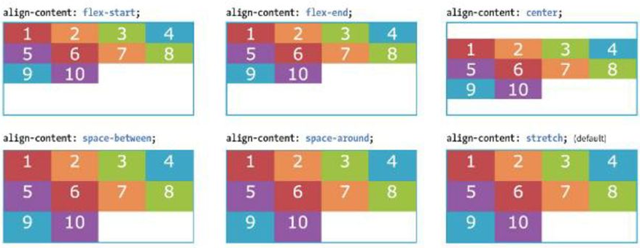
Flexbox Alignment
align-content
flex-start | flex-end | center | space-around | space-between | stretch
The align-content property applies only when there are multiple wrapped flex lines .

Slide 18
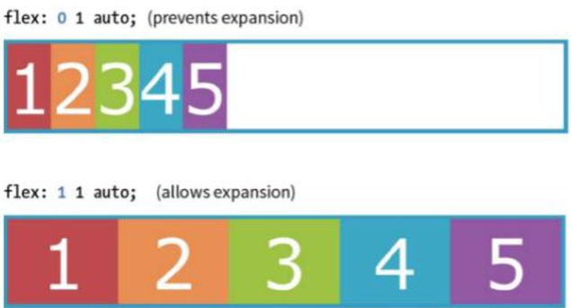
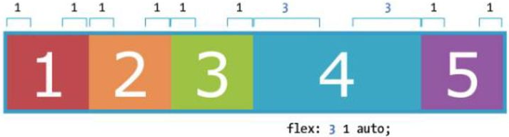
Flex item - Properties
flex-grow
The Markup
<div id=”container”>
<div class=”box box1”>1</div>
<div class=”box box2”>2</div>
<div class=”box box3”>3</div>
<div class=”box box4”>4</div>
<div class=”box box5”>5</div>
</div>
The Styles
.box{
flex: 1 1 auto;
}
Value: number Default: 0
A flex-grow value of “3” means the item receives three times the amount of space than the remaining items set to flex-grow:1
.box4{
flex: 3 1 auto;
}

Slide 19
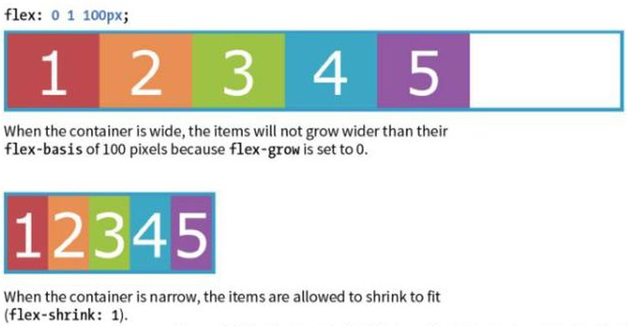
Flex item - Properties
flex-shrink
flex-basis
Value: number Default: 1
Value: length | percentage | content | auto
Flex-basis defines the starting size of an item before any wrapping, growing or shrinking occurs. It may be used instead of the width property (or height for columns) for flex items.
By default, flex-basis is set to auto (width/height value of item size)
If item’s size is not defined or set to auto - flex-basis uses the content width.
When flex-shrink is 0, items are not permitted to shrink and may hang out of their containing element
Flex items stop shrinking when they reach their minimum size (defined by min-width/min-height).
The Styles
.box {
flex: 0 1 100px;
}

Slide 20
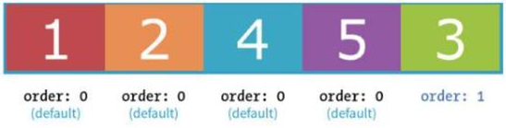
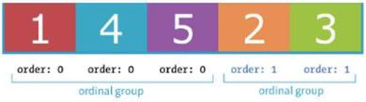
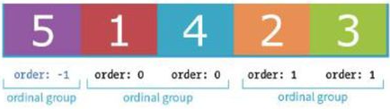
Flex Item Properties
order
Value: integer | Default order value is ‘0’
The order property give the ability to display items in an order that is different from the order in the HTML source code.
If items have the same order value = laid out in order they appear in code
If items have different order values = arranged from the lowest order value to highest.
.box3{
order: 1;
}
.box2, .box3{
order: 1;
}
.box5{
order: -1;
}

Slide 21
THANK YOU

